Slide 1
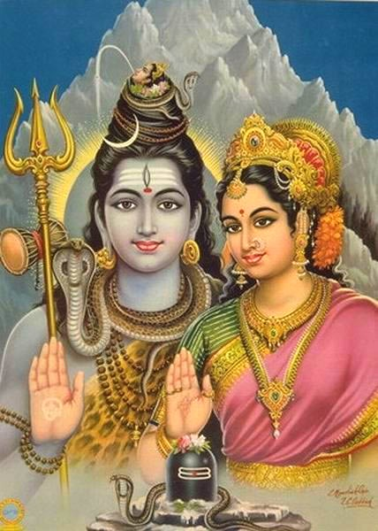
Sri Jagannath Center

Slide 2
Sri Jagannath Center
Dasamsa:
Loss and Gain
in Career
Presentation by
Raghunatha Rao Nemani
Copyright © 2004, Aug 21-29 2004 - SJC West Coast Conference

Slide 3
Introduction
Introduction
Prayers

Slide 4

Introduction

Slide 5
Agenda
Houses,D-Charts
The 10th House, Dasamsa
Determining Profession
Judgment of Loss & Gain in career
Using Various Dasa ’s
Conclusion & Remedies
Example Charts:
Determining Professions
Gain and Loss In Career
Questions & Answers

Slide 6
Basics
Basics,
Basics,
Principles
and
Principles

Slide 7
Divisional Chart: 5 Cycles
1st Cycle: Vargas D-1 through D-12, Physical plane
2nd Cycle: Vargas D-13 to D-24, Conscious (Mental & Intellectual) Plane.
3rd Cycle: This includes Vargas D-25 to D-36, Sub-Conscious Plane
4th Cycle: Vargas D-37 to D-48, Supra Conscious Plane.
5th Cycle: Vargas D-49 to D-60, This cycle is beyond the spiritual world, and goes directly into the past lives of the native himself.

Slide 8
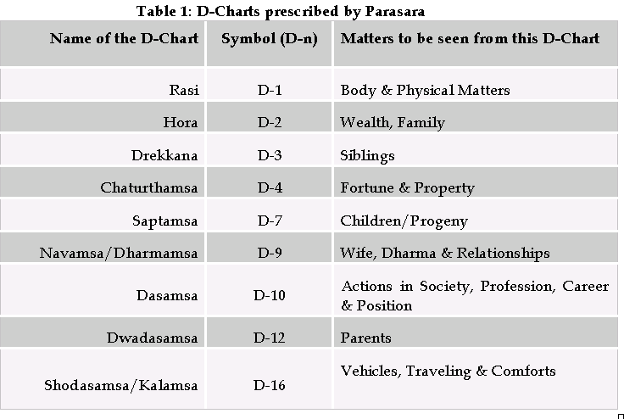
D-Charts prescribed by Parasara

Slide 9
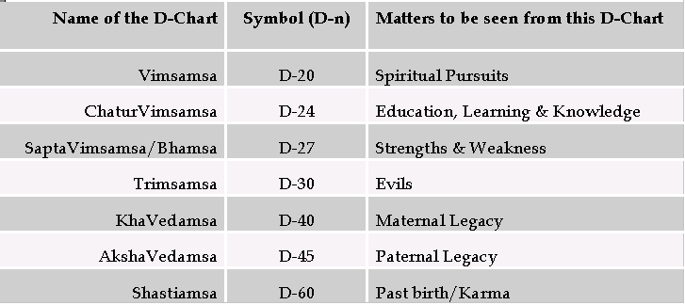
D-Charts prescribed by Parasara

Slide 10
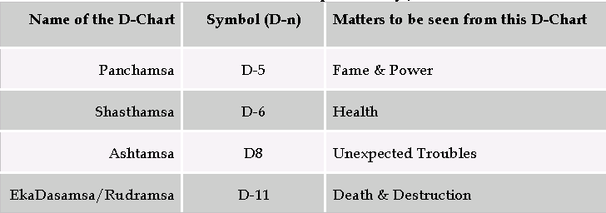
Additional D-Charts emphasized by Jaimini

Slide 11
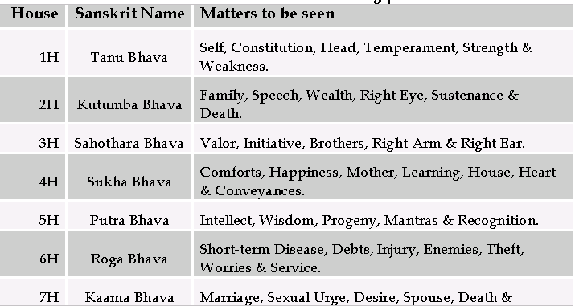
Houses and its Meanings

Slide 12
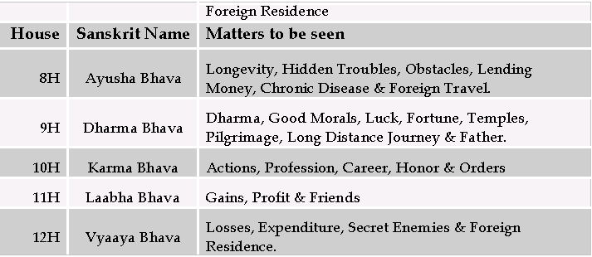
Houses and its Meanings

Slide 13
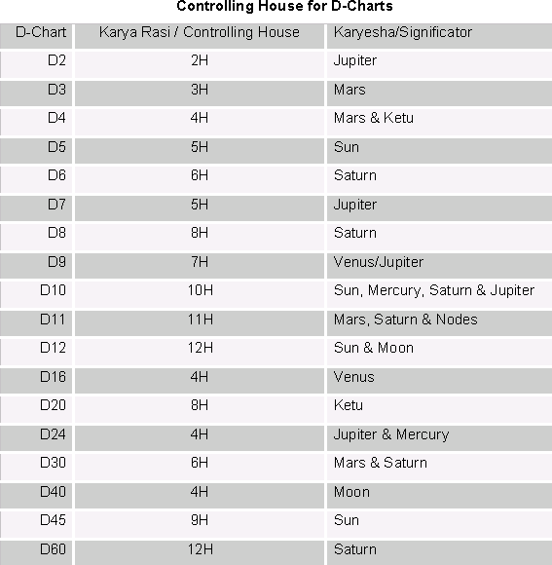
Controlling House for D-Charts

Slide 14
What are these, Confused?
-What is Rasi
-What is D-10
-What are the
- Special
Lagnas
Paaka Lagna
Narayana Dasa
-Planets in 10th House
-10th Lord and its Placement
-What is Artha Trikona
-1st, 5th and 10th Houses
- Kaama Trikonas
-Service or Business
-6th and 7th Houses
-2^{nd,} 11th and 8th houses
-Yoga’s
-Karakas
-Rasi and Graha
Drishti
-Combinations for
Good and Bad Career
Profession Determination
-Arudha Lagna, Pada
- Operating Dasas
-Profession determination
-Rasi Tulya
Dasamsa
- A10
-Job Loss/Gain When
-Promotion,Layoff

Slide 15
Integrated Approach to D-10
Vimsottari
Dasa
A10
Narayana
Dasa
Karakas
-What is Artha Trikona
-1st, 5th and 10th Houses
- Kama Trikonas
D-10
D-10
Rasi Tulya
Dasamsa
-Arudha Lagna
- Operating Dasas
-Profession determination
Job Loss/Gain
-Promotion,Layoff
-Planets in 10th House
-10th Lord and its
Placement
More accurate Analysis and Prediction

Slide 16
What the 10th House Represents
The Tenth House represents mid-heaven and plays an important role in any chart.
The planets in the 10th house give good results, because it is one of the Upachaya Bhavas besides being the most powerful Kendra.
The Sun and Mars, who get directional strength in the 10th house, can be a great blessing by providing dynamism and success.
The 10th house has Argala on the 6th, 7th, 9th and 12th houses.
Good influences on the above houses automatically affect the status and profession ruled by the 10th house.

Slide 17
What is Dasamsa
As the name would explain, the word Dasamsa comprises of two words, Dasa (Ten) and Amsa (Division). Thus, it is the one-Tenth division of a sign.
As we have seen earlier, the Dasamsa falls in the 1st cycle of Vargas, i.e. from D-1 thru D-12. These have to do with the physical plane.
Dasamsa or D-10 is used to shed more light on career or professional activities and also is used to predict matters relating to career, status, achievements, one’s role in the society, etc
NOTE: The Rasi chart should be given more importance than any of the D-chart’s. Normally a D-Chart cannot give what the Rasi chart cannot promise. The D-Chart has to support the Rasi chart for full fructification in order for the Rasi chart to be realized, while the Rasi indicates the physical manifestation, the D-Charts indicates the environment for the specific aspects of life.

Slide 18
Determining Profession
One should consider the following factors in determining one’s profession and career:-
Lagna.
The Planets in the Tenth House.
Planets Aspecting the Tenth House.
Lord of the Tenth House.
10th lord & Dispositor in Navamsa D-9.
Artha Trikonas: 2nd, 6th and 10th houses.
Navamsa (D-9) & Dasamsa (D-10).
10th House Karakas: Sun, Merc, Sat and Jup.

Slide 19
Importance of Various Lagna’s
Lagna (Ascendant)
This shows the true self of the native at a physical/ body level.
Chandra Lagna (Moon Lagna)
The Moon Lagna indicates one's inclinations, ambitions, happiness, views, liking for things around him and what he loves or is inclined to do.
For example: If the 10th house from the Lagna is under the influence of Saturn, then the native may be hardworking and doing a routine job. But Mars in the 10th house from the Moon will make him active and enterprising.

Slide 20
Importance of Various Lagna’s
Surya Lagna (Sun Lagna)
The Surya Lagna indicates physical vitality. A strong 10th house from the Sun will give immense strength to fight against all odds in spite of a weak physical body, structure, or environment.
Arudha Lagna (Pada Lagna)
AL shows the perceived self. It shows the maya associated with the person. The true self is hidden inside the person and the world cannot see it.
Arudha means, “risen one” and it shows what rises and becomes visible to the material world. AL shows one’s image and status in career. The 10th house from AL shows the forces supporting one’s image. Natural benefics in the 10th house from AL gives a good image and malefics give a bad image etc.

Slide 21
Importance of Various Lagna’s
Paaka Lagna
Paaka Lagna is the sign where the Lagna Lord is placed. Similarly, every house has its own Paaka Sthana.
Paaka Lagna throws light on matters related to the physical self (i.e. how the native uses his potential at a given moment or opportunity).
Ghati Lagna
Ghati lagna is at the position of Sun at the time of sunrise.
This is also called “Ghatika Lagna” (GL). The GL is used to see ones position in society, or, more accurately it is a seat of Power and/or Influence in the chart. Its placement and strength will be important when examining a chart for rise or decline in position of power and authority as it relates to the 5th house.

Slide 22
Importance of Various Lagna’s
Hora Lagna
Hora Lagna is at the position of Sun at the time of sunrise. It moves at the rate of one Rasi per hora (hour). HL is used to see ones Wealth, and it is also related to the 2nd house of the native's chart.

Slide 23
Planets in the Tenth House
The planet(s) in the 10th house, its lord or 10th Lord’s navamshesh and planets aspecting it indicates one’s career. If there are more than one planet then we have to take the following considerations, such as: -
Do the planets influence each other mutually (Drishti Sambandha)?
Are there any yoga’s formed by the conjunction of these planets?
If there are no planets in the 10th house, then we have to consider the 10th lord and various planetary influences on 10th house

Slide 24
Planets in the Tenth House
Look for special conditions, such as retrogression, combustion, graha-yuddha, or debilitation.
Vipareet Raja-Yoga is important to see w.r.t. Career, as a person may fall badly from his career, yet may suddenly get re-hired into a better position.
All these Yogas must also be seen with the reference of the 10th from Moon, Sun, Lagna, AL, etc.

Slide 25
10th lord and its placement
It is important to see the 10th lord’s placement with other houses in judging one’s career.
You can read any standard texts for the detailed explanations on the 10th lord placement in various houses. So I will not go into all of the principles here, but some of them are:-
Tenth lord in Angles (1st, 4th, 7th and 10th): Generally good because these are Vishnu’s Sthana.
Tenth Lord in Trines (1st, 5th and 9th): Good because these are Lakshmi’s Sthana and they lead to prosperity.
Tenth lord in 2nd (finance/wealth) or 11th (fulfillment/gains): Wealth giving places.
Tenth lord in 3rd house: Since it is an Upachaya house, so hard working and good for career.

Slide 26
10th lord and its placement
If the 10th lord is placed in the 3rd or 5th houses, the native has short lasted jobs. This is because they are the 6th and 8th houses from the 10th.
Tenth lord in 6th, 8th and 12th (Trik): One can expect ups and downs, obstacles, and changes (not always bad though rise and fall are quite dramatic some times). Here 6th is probably better since it is an Upachaya house as they denote improvement / growth.

Slide 27
Influence of other houses on profession
Importance of 2nd and 11th Houses
The native’s source of income is seen from the 11th house. Let us take an example, if Mercury is the tenth lord and is placed in the 11th house and it is with Mars and in D-10 in a fiery sign, then the native may be an accountant (mercury) employed with defense / military (Mars and fiery Dasamsa). Here 10th determines the native's profession and 11th house determines the source of income.
In this manner we should properly scrutinize both houses. Second house is the house of wealth and finances. In fact, second house and the eleventh house and their lords should be strong for a financially rewarding career. I will describe various Dhana Yoga’s in this article later.

Slide 28
Influence of other houses on profession
Importance of 5th House
The 5th house is the 8th from the 10th, representing birth (beginning) and longevity of the 10th house. Thus, the 5th house rules the authority and power that one enjoys due to one's skills and knowledge as well as Purva Punya (5th House). The timing of joining a new job is done from the 5th house.

Slide 29
Influence of other houses on profession
Importance of 6th and 7th Houses
The 6th house rules service and the 7th house rules business. If there are more planets in the sixth house, or it is stronger, service is indicated. A stronger 7th house gives a business enterprise.
Similarly, the 6th lord promotes service while the 7th lord promotes business. The Dasa period of 7th lord may bring instability in service. A debilitated malefic in the 7th house or malefics in the 8th house (being 2nd from 7th), will encourage service and damage business. Saturn in 7th house is karaka for 6th; hence the native will still be doing service. Similarly Venus is karaka for 7th and if placed in the 6th, will do some kind of business.

Slide 30
Influence of other houses on profession
Service
The boss is seen from the 9th house while subordinates are seen from the 5th house. During the period of a malefic planet having Papa Argala on the 9th house, one is tormented by one's boss. Benefics having Subha Argala on the 9th house shall give a very good and helpful boss.
In a chart showing potential for employment, the concerned houses for self are the 1st, 6th and 10th. The 3rd house from these (the 3rd, 8th and 12th) can cause problems. The 8th house will show retirement, the 3rd house shows short leave, while the 12th house shows long leave.

Slide 31
Influence of other houses on profession
Business
The ascendant lord in the 9th house makes a person very independent and business is best advised to native such charts or at least employment with a lot of scope for free enterprise. The 2nd house is the 8th from the 7th house and shall play a crucial role in starting any business.
Similarly, the starting of any business is determined by the availability of finance. The quadrants to the 2nd house are the 5th, 8th and llth houses, indicating the money that is put in by the partner (5th house is 11th from the house of partner i.e. 7th), loans from banks etc., and the self respectively.

Slide 32
Influence of other houses on profession
Importance of 8th House:
The 8th house, being the 11th from the 10th house, is the place of retirement or end of career. The 8th house, if beneficially disposed, can give huge loans to take up large enterprises and its Argala on the 7th and 10th houses can give a new boost to business. If ill disposed, one's business will run into endless debt and ruin the business.

Slide 33
Combinations for Good and Bad Career
The following placements & combinations indicate a good career & recognition at work:-
D-1’s Lagna lord in D-10 lagna
D-1’s Lagna lord in good houses in D-10.
D-1’s 10th lord or planets in the 10th house of D-1 are well placed in D-10.
D-10’s Lagna lord well placed in D-1
D-10’s 10th lord well placed in D-1
D-10’s 9th Lord or 11th Lord or 2nd Lord are placed in benefic places in D-1
Rasi Tulya Dasamsa
Note: Here “well placed” and “good houses” means the planets are either in Kendra, Trikona, 2nd or 11th and no malefic conjunctions or aspects.

Slide 34
Importance of Arudha’s
The Lagna represents true self, while Arudha Lagna (AL) represents how others perceive you. It shows the maya (illusion) associated with the person.
Here the AL shows one’s image and status in one’s profession/career from the Dasamsa’s point of view.
The 10th house from AL shows the forces supporting one’s image. Natural benefics in the 10th from AL give a good image and malefics give a bad image. The 2nd house from AL shows the factors that provide the resources that one’s image can draw from. Malefics in the 3rd (Parakrama / Velour) and 6th houses from AL give rise to fortune through bold acts.

Slide 35
Importance of Arudha’s
Benefics in the 8th from AL give sudden gains to one’s image and malefics in the 8th from AL give losses. Any planet (even an Upagraha) in the 9th house from AL protects one’s image and keeps one’s status intact.
Planets in the 11th from AL give gain in status while planets in the 12th from AL give losses. But if Rahu, Sat or Ketu gives Raja Yoga, if they are placed in 12th from AL.

Slide 36
Debilitated planets and its effects in Dasa
Debilitated planets in 3rd, 6th or 8th houses will behave as strong as exalted planets. This is especially true if such planets are also in Marana Karaka Sthana. Also, debilitated and retrograde malefics in kendras will produce the effects of Raja-yoga in their Dasa periods, and especially if kendra and the trinal planets are conjoining or aspecting. Finally, exalted but retrograde planets will produce weak results.
The Dasa periods of retrograde planets with respect to Career could bring the fulfillment of strong career desires that the native has held for many lifetimes.

Slide 37
Combinations for some professions
Lawyer or Judge
The 6th house (court cases) and the 9th house (law) are important when looking for career in law. Jupiter rules law and the two signs owned by Jup are Sg and Pi, so these two houses represent the law too. Li is the most important sign to look into, as it is the sign of judgment and it is also an airy sign.
If the above are strong and connected with the tenth house & Lagna then the native's career will be connected with law. If Le and Sun also get involved in the above, then the native surely will receive income from the Government and the native may be a judge or a government lawyer. Please note, Sat connected with Li and the 10th house or Jupiter gives legal career too.

Slide 38
Combinations for some professions
Defense and Police Personnel
The signs owned by Mars are Aries and Scorpio and they are important for police / defense related professions. The 3rd house (valour) and 6th house (wars) will also be prominent in the horoscope too. In fact, one has to consider all the fiery signs for defense and police related professions.

Slide 39
Combinations for some professions
Astrologers
In the horoscopes of Astrologers Jup, Merc and Airy signs should be prominent. Further if 2nd house is powerful then it gives knowledge and also “Vaksiddhi” (Vaksiddhi means, whatever the person predicts will come to pass by the practice of Satya and prophecy).
If 5th house is powerful and 5th lord is also connected to the Mars (an airy signs), then one gets intuition. Thus it is important to have a strong 5th house for being a competent astrologer.

Slide 40
Combinations for some professions
Engineers
One has to see the prominence of nodes in a native’s horoscopes of Engineers. Mars indicating tools, Sat the use of these tools and Ven, which gives refinement to their use, are also prominent in the horoscopes of Engineers.

Slide 41
Combinations for some professions
Medical Profession
Sun, Mars and Jup should be strong along with Ketu who is always prominent in horoscopes of doctors. Sun rules the soul (also healing) and is the “life-giving planet”. Sc rules drugs, medicines etc and therefore, its lord Mars should also be connected with the 10th house.
Rahu is important for medical careers, given its connection to drugs and poisons. If Mars or Ketu or Mercury (skin and cuts) is strongly connected with the tenth house and its lord, it makes the native a surgeon.

Slide 42
Combinations for some professions
Artists
Venus is the Karaka of fine arts, music and dancing. Its association with Moon, Mercury, and Jup gives artistic talent to the native. Houses owned by Venus, i.e. Ta and Li, should be prominent. 3rd house and Merc should also be prominent. 5th and 6th lord should show creative abilities so these houses should also be connected too.
In cases of singers and poets, 2nd house will also be prominent because 2nd house rules speech.

Slide 43
Judgment of Loss & Gain in Career in Dasamsa
The following are some indicators of a good career or rise in career in the Dasamsa: -
Strong 10th House in D-10: Status, recognition and great achievements
Planets in the Lagna or Lagna lord in D-10
Planets in Kendras and Trikonas
Dasa lord or Antardasa lord getting connected to the D-10 Lagna
All results indicated by a planet in the Rasi and D-Chart come to fructification in their Dasa, Antardasa and Transits.

Slide 44
Planets in Kendras
The Kendra houses are the angles of the chart and they are 1st, 4th, 7th, and 10th. These are considered the most powerful houses of all (in ascending order). Being Vishnu’s Sthana, planets in Kendras are auspicious. Even malefics in Kendras are not bad for career.

Slide 45
Planets in Trikonas
The Trikona houses are 1st, 5th and 9th and these are the most auspicious houses of all. Being Lakshmi’s Sthana, they symbolize prosperity. Planets in Trikonas in D-10 are also good. Planets in or lords of 1st, 5th and 9th are good for career.
Please make a note; while placement of any planet in 5th or 9th is highly auspicious, it might not be so in all cases where the 10th lord is in 5th or 9th. This is because these are the 8th and 12th from the 10th, and thus could prove to bring obstacles or loss of career if the 10th lord therein is afflicted. Similarly the 3rd house is the 6th from the 10th.

Slide 46
Planets in Trikonas
In my studies, I have found that people often lose or change the careers when the Dasa of the 10th lord placed in these houses comes into effect. This of course, would be different if the native's career were associated with education, spirituality, counseling, coaching, art and music as in the 3rd lord etc.

Slide 47
Planets in Dusthanas
Dusthana’s are 6th (makes us to work harder), 8th (gives end of work) and 12th (gives end/change of profession) signify difficulties, obstacles, and struggles. Therefore the planets in 6th, 8th and 12th in D-10 indicate difficulties, tensions, and worries with respect to career especially if they are unaspected by lagna lord or 10th lord. If aspected by the Lagna Lord or 10th Lord gives initial difficulties followed by relief.
When the Dusthana’s lords of D-10 are related to the 10th house or 10th lord, the Dasa or Antardasa may be tough.

Slide 48
Planets in Dusthanas
Antardasa lord in 6th, 8th and 12th from Dasa lord in D-10 indicates difficulties and tensions with the following modifications:
If the Antardasa lord is not in 6th, 8th and 12th from Dasa lord in the Rasi chart, and is well placed or if he is in the 4th or 10th in the Rasi chart, then initial difficulties which are overcome with eventual success.
Note: However, if the native is a police officer or soldier, for example, then lagna lord or 10th lord in the 6th (in strength) will be important for career. Individuals who do research or investigation, science or diagnostics, surgery, as well as astrology and metaphysics, are going to have strong planets in the 8th house. Persons who work in hospitals or prisons, as well as monasteries or churches, or who relocate to foreign countries as part of their professions, are going to have strong career-related planets in the 12th house.

Slide 49
Planets in the Upachayas
Upachayas are houses of growth or improvement. Planets in these houses i.e. 3rd, 6th, 10th, 11th generally give good results eventually with somewhat hard work and struggle.
The benefics are good in the 10th and 11th. Benefics are fine in the 3rd, and may not be good in the 6th. Malefics in the Upachayas are generally good.

Slide 50
Transits and the Dasamsa
The following planets promote the career matters, so observe their transits:
Planets in the 10th and 10th lord in D-10
Lagna lord and lagna in D-10
10th house and its lord in Rasi
Planets in the 10th in D-10 can trigger a rise in career or some favorable event with respect to career while transiting over the D-10 lagna or D-10 lagna lord.
D-10’s tenth lord’s transit over the Rasi’s 10th house or Rasi’s 10th lord can also trigger some favorable event or rise in career, especially during the Dasa or Antardasa of such lords.

Slide 51
Transits and the Dasamsa
When we analyze a chart from all the above-mentioned angles, we will be able to categorize the various points as follows:
A planet is benefic in the Rasi and well placed in the Dasamsa: Rise in career, achievements in public life, position, honor and great results (mahat phalam).
A planet is benefic in the Rasi but badly placed in the Dasamsa: Will give results, but after some struggle.
A planet owns a malefic house (3rd, 6th, 8th and 12th) in Rasi and placed in benefic places in Dasamsa: Maleficience gets greatly reduced, with respect to career matter only.
A planet is bad in both the Rasi and Dasamsa: Fall, disgrace, or suspension etc are possible.

Slide 52
Transits and the Dasamsa
Transits are to be studied from both the Moon and the Lagna. While studying transit from the lagna, remember the following points:
See and study the transits in the same manner as planets in their natal position. The planets transiting 6th, 8th or 12th become weak.
Give special attention to the transits of major and sub-period lords. If the transit 6th, 8th or 12th or their debilitation sign or are combust in transit, then adverse results are experienced.
Transit of Jupiter over natal position of a planet is good. Jupiter if in transit aspects the natal position of major lord or sub period lord gives beneficial results.

Slide 53
Transits and the Dasamsa
Jupiter activates the sign it transits. It also activates a Raja Yoga or Dhana Yogas when it aspects in transit. This will be so even if the Dasa of the concerned planets in not in operation.
Saturn, when transiting over natal position of a planet, gives misfortunes. Its aspect is also bad. Saturn transiting in the 7th from or over natal Sun causes unfortunate developments in a native's career. Operating sub period lord decides whether the native will overcome these adversities or not.
Benefics transiting over natal position of Dasa lord help the native and malefics cause difficulties to the native.

Slide 54
Argalas
The tenth house has Argala on the 6th, 7th, 9th and 12th houses. Thereby directly affecting enemies, servants, fortune, and sleep that are ruled by these houses and other matters.
The 11th, 1st, 2nd, and 8th houses have Argala on the 10th house and are capable of affecting the actions and other matters ruled by the tenth house. Thus gains, self, net profit, loss, which will influence decisions and actions. In this manner, the Argala's and their obstruction should be understood and should be used with reference to Dasa ’s.

Slide 55
Yogas
In addition, we have to see whether the following Yoga’s are present and functional in native’s chart:
Raja Yogas (for power, authority and prosperity)
Dhana Yogas (for wealth)
Lakshmi Yoga (for wealth and prosperity)
Arishta (Poverty) Yogas (which gives poverty to the native)
Neecha Bhanga Raja Yogas
Vipareeta Raja Yoga

Slide 56
Dasamsa Deities
Dasamsa Deities associated with each of the 10 directions, which are the cornerstones of the Dasamsa chart. These are the same directional Deities as are ascribed to the Kalachakra. Planets in transit in Nakshatras aligned with spokes on the Kalachakra that are malefic, may bring many troubles to the person.

Slide 57
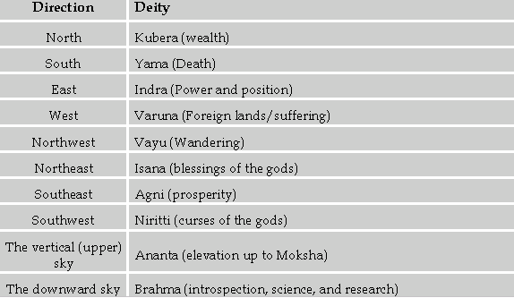
Dasamsa Deities

Slide 58
Dasamsa Deities
For example, if the 10th lord in a Nakhsatra pertaining to the NorthEast direction, this could bode auspicious for the native as that direction is ruled by Isana and suggest blessings.
On the other hand, if a natal or annual planet pertaining to career and work (10th lord, AmK planet, Sun or other natural karaka, or lagna lord) were in a nakhsatra pertaining to the southern or southwestern directions as per the Kalachakra, then it could bode as evil for the native, as these are ruled by Yama and Niritti respectively (death and curses).

Slide 59
Astakavarga
Astakavarga is important in assessing the strengths of houses and planets.
Planets ruling Dasas in specific houses, or planets transiting in such houses, will have greater or lesser effect for good or ill, depending on their bindus in BAV as well as SAV in Rasi as well as D-10 charts.

Slide 60
Using Various Dasa ’s
Vimsottari Dasa
During the Dasa, Antar Dasa and Pratyantara Dasa of a planet who is in 3rd, 6th, 8th or 12th to the Rajya Pada (A10) gives a change in job. If malefic planets are there, then hardships are indicated and if benefics are placed then a good job and authority in job is indicated.
If such a planet from A10 is in debility or combust, then the person looses the job during either Dasa or Antara or Pratyantara Dasa of such a planet.

Slide 61
Vimsottari Dasa
Transit of Shani over this A10 in D-10 indicates a change of job. Guru's placement in D-9 chart and Shani's transit over Guru indicates, there will be a change of job for good and further he/she will attain prestige and promotions in that new job.
Also when Guru transits or aspects A10 in D-5 chart, the native's job will be honored and will become famous and known to the community / world.
In D-10 chart, if the Lagna is in chara/watery sign and its lord is placed in such signs and also if 9th lord is placed in such signs including 7th and 8th lord, then during the Dasa /Antara Dasa or pratyantara Dasa of such planets or planets occupying such houses, the person goes abroad for improvement of his career.

Slide 62
Vimsottari Dasa
If Rahu he occupies in Chara /watery signs, associated with the lords of 7th, 8th, 9th or 12th houses then the person goes to abroad during his Dasa /Antara Dasa /Pratyantara Dasa periods.
For promotions: Look at the planets, which are the lord of either 5th, 9th or 10th house from 10th house in Natal chart. Also 5th, 9th or 10th from 10th house in D-10 chart and during the Dasha / Antara / Pratyantara of such planets, the native will get promotions. Also see in D-9 chart, if transit Guru transits over or aspects to A10, there will be a change for good and sometimes promotions also will be there.

Slide 63
Vimsottari Dasa
The planets in 5th, 9th or 10th houses from A10 including A10 lord during their Dasha / Antara / Pratyanatara will give promotions, salary raise etc.
If the Badhakadhipaty from A10 is also joined with any one of the 3rd, 6th, 8th and 12th houses, then there will be change of the job for a reduced salary than before.
During the Dasha / Antara / Pratyantara of planets posited in Badhaka sthana and 7th from Rajya Pada, A10 in D-10 chart will lead to loss of job. The reason is 7th is maraka for any house.
Similarly, during the Dasha / Antardasa of planets posited in Badhaka sthana and 8th from A10 in D-10 chart indicates the end of career if A3 also coincides with the planet in 8th from A10 in D-10 chart.

Slide 64
Narayana Dasa
Narayana Dasa is an important Rasi (Phalita) Dasa. Its versatility lies in the fact that it can be computed separately for each divisional chart for precise timing of specific matters. In fact, we can compute more than one Narayana Dasa for each divisional chart. Narayana Dasa of D-10 seeded from the 10th lord is native-centric. It shows events in a native’s life that are related to career and profession.
During the Dasa, Antar Dasa and Pratyantara Dasa of a planet who is in 2nd, 3rd, 6th, 8th or 12th to A10 / AL gives a change in job. If malefic planets are there, then hardships are indicated and if benefics are placed then a good job and authority in job is indicated. If such planet from A10 is in debility or combust, then the person looses the job during either Dasa or Antara or Pratyantara Dasa of such a planet.

Slide 65
Sudasa
Sudasa is a Rasi Dasa. It is also called “Sree Lagna Kendradi Rasi Dasa ” or simply “Rasi Dasa”. Its computation is based on kendras from Sree Lagna. Sudasa is important for materialistic things like Money, Power and Authority. It can be used to predict financial matters and matters related to status and power. If a political leader occupies a post of power, he must be enjoying a favorable Dasa as per “Sudasa”. If a businessman sees increasing profits, it must be enjoying a favorable Dasa as per “Sudasa”. If someone struggles with tight finances, he must be going through an unfavorable Dasa as per “Sudasa”.
Dasas of HL, 7th from HL, and the signs aspecting HL bring Financial Prosperity. If the lord of the Dasa sign occupies or aspects HL, it will improve the chance of financial prosperity.
Similarly, if the lord of HL occupies or aspects Dasa sign, it will also improve the chances of financial prosperity.

Slide 66
KalaChakra Dasa
Sage Parasara called Kalachakra Dasa “the most respectable Dasa of all Dasas”. Kalachakra literally means “the wheel of Time”. Parasara said that Lord Shiva explained this Dasa to Goddess Parvati. It shows how the wheel of time unfolds events in the life of an individual.
Dasa of a Rasi gives the natural results of the Rasi. For example, Dasa of Pisces may give saattwik religious activities. Dasa of Aries may give enterprise or quarrels or wounds.
More importantly, Dasa of a Rasi gives the results of the house and planets in that Rasi. If Sc has AL in D-10 and its lord Mars occupies it, its Dasa may bring good developments related to career and status. Dasa of a Rasi containing the 8th from AL in D-10 may give a fall in status at workplace. If Mars is in the 5th house in D-7, Aries Dasa may give children and so on.

Slide 67
KalaChakra Dasa
Samudaaya Ashtakavarga (SAV) plays an important role in deciding the results in a Dasa. If a Rasi has too many or too few rekhas in SAV of a particular divisional chart, then its Dasa may bring favorable or unfavorable results respectively, relating to the significations of that house in that D-Chart.
Note: Kalachakra Dasas date’s change by about 3 months, if birth time changes by 1 minute. So one has to have an accurate birth time before using this wonderful dasa.

Slide 68
Summary
We can give more precise and accurate predictions if we remember the following:
First, look at the prevailing major and sub-periods.
Then, see the transits from Moon, from natal Sun, 10th lord and also the ascendant. The transit of major and sub-period lord should be seen. They give adverse results when transiting the 6th, 8th or 12th house from natal ascendant.
See if there are any Raja Yogas, Dhana Yogas, Arishta (Poverty) Yogas and other Yogas in the horoscope. Jupiter in transit when aspecting a good Yoga activates it and Saturn in transit when aspecting a bad Yoga activates it.

Slide 69
Summary
See the position of major and sub-period lord in the Dasamsa chart. They will give bad results if placed in the 6th, 8th or 12th house, or in debilitation or inimical houses. The position of Dasamsa Lagna, the 10th house and their lords are important. If a planet is connected with the 10th or 2nd house in Rasi Chart and badly afflicted or weak then it will not give good results even if it is very well placed in the Dasamsa Chart.
The Ascendant, Sun, and Moon are the three pivotals of a horoscope. Sage Parasara in the Chapter on Sudarshana Chakra has given them a great importance. If they are all powerful and well placed, the native will rise very high in life. If these three are weak and afflicted, the native will lack initiative, and enterprise, and will not be able to achieve much in life.

Slide 70
Summary
The Badhaka lord creates obstacles. It cannot deny an event on its own but will certainly create difficulties and obstacles. (For ascendant of Movable, Fixed & Dual Signs the sign of obstruction Badhaka is the 11th, 9th, & 7th house respectively.)
Always cast Annual Tithi Pravesha Charts for confirmation of the event.

Slide 71
Summary
Lastly, I have found that the following approach works very well for more accurate prediction:
First, choose the Narayana Dasa of the Rasi chart (D-1) to isolate the most likely time that an event could occur.
Then, see if Vimsottari Dasa (or other nakhsatra Dasas) agrees for the same time period.
Next, choose the Narayana Dasa of the specific varga chart for the area concerned. For example, use the Dasamsa Narayana Dasa (D-10) if the event relates to career.
Finally, see if beneficial transits (or the opposite in the case of a negative prediction like death, etc.) reinforce the occurrence of the event. You can see the transits of planets (most importantly Saturn, Jupiter, and Rahu), not only over the signs/houses of the Rasi chart, but over those of the related varga charts as well.

Slide 72
Summary
When a person experiences difficulties in his/her career, the Jyotirlinga deity of 5th lord in D-10 chart can be appeased with the following Jyotirlinga mantra to overcome the problems in career.
Also, once should recite the “Surya Astakshari Mantra” which is “Om Ghrinih SuryAaditya” to get blessing of Lord Surya to get a Job / Work.

Slide 73
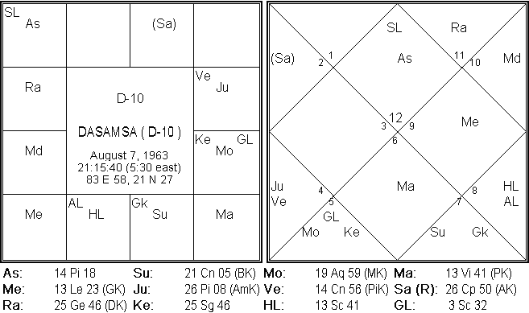
Conclusion
Now you can see what is going on inside the
Dasamsa
Notes:
Any additional comments or concerns? What have we missed?

Slide 74
Principles at Work
Let us do some
Case Studies
Notes:
Any additional comments or concerns? What have we missed?

Slide 75
Questions & Answers
Notes:
Any additional comments or concerns? What have we missed?

